Slide 1
Basics of cardiac ventriculography

Slide 2
Introduction
Indications
Contraindications
Preparation of patient
Access – techniques
Catheters
Angiographic Views
Interpretation
Complications

Slide 3
Introduction
In 1929 Werner Forssman, inserted a urologic catheter into his right atrium from a left antecubital vein cut down he had performed on himself using a mirror.
Retrograde left heart catheterization was first done by Zimmerman,Limon Lason & Bouchard in 1950’s (Nobel prize in 1956).
Used to be the only method available for assessing LV segmental dysfunction.

Slide 4
Cardiac ventriculography is used to define the anatomy and function of the ventricles and related structures in patients with congenital, valvular, coronary, or myopathic heart disease.
Provides valuable information about global and segmental left ventricular function, mitral valvular regurgitation, and the presence, location, and severity of a number of other abnormalities such as ventricular septal defect and hypertrophic cardiomyopathy.
Included as part of the routine diagnostic cardiac catheterization protocol in a patient being evaluated for coronary artery disease, aortic or mitral valvular disease, unexplained left ventricular failure, or congenital heart disease .

Slide 5
Indications
Usually an elective procedure.
Diagnostic – discreprancy between the symptoms and clinical features of patient.
▪ Valve area, cardiac output and resistance.
Quantification of shunts
Pressure gradients
Therapeutic – useful for assessing the pressure gradients before and after
▪ Mitral Stenosis – PBMV
▪ Aortic Stenosis – PBAV
▪ PDA device closure
▪ HOCM – alcohol septal ablation
▪ Cooarctation of Aorta
▪ Aorto Pulmonary Window closure

Slide 6
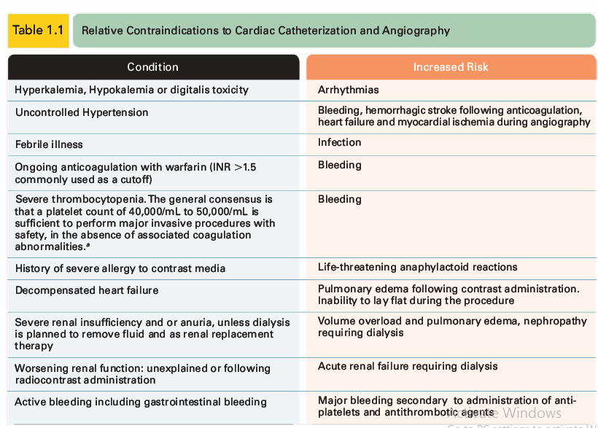
Contraindications
The only absolute contraindication to cardiac catheterization is the refusal of a mentally competent patient to consent to the procedure

Slide 7
Preparation and premedication
Informed consent – simple terms, steps of procedure, complications (usually taken by operator).
All peripheral pulses to be felt.
The guidelines by the American Society of Anesthesiologists currently recommend a minimum of 2 hours fasting period after clear liquids, and 6 hours after a light meal.
For diabetic patients – dose of NPH insulin should be cut by 50% (overnight fast with normal dosing of insulin – hypoglycemia).
To stop metformin – 48 hrs before procedure – lactic acidosis.(no evidence for clinical benefit).
Adequate hydration. (urine output > 50ml/h)
Anxiolytic
Shaving of the both forearms and inguinal regions.
IE prophylaxis if valvular heart disease.

Slide 9
Local anesthesia
Once the inguinal ligament and femoral artery have been identified, the femoral artery is palpated along its course using the three middle fingers of the left hand, with the uppermost finger positioned just below the inguinal ligament.
Without moving the left hand, a linear intradermal wheal of l% or 2% lidocaine is raised slowly by tangential insertion of a 25- or 27 -gauge needle along a course overlying both the femoral artery and vein at the desired level of entry.
The smaller needle is then replaced by a 22-gauge 1.5-inch needle, which is used to infiltrate the deeper tissues along the intended trajectory for arterial and venous entry.
Approximately 10 to 20 ml 1% or 2% Xylocaine administered in this fashion usually provides adequate local anesthesia.

Slide 10
Access
Femoral artery/vein
Modified Seldinger technique.
Fluoroscopy guidance

Slide 12
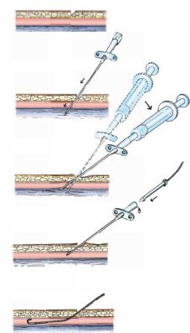
Femoral Artery Puncture
The original Seldinger technique for cannulation of the femoral artery consists of advancing the Seldinger needle completely through the artery until the periosteum is encountered.
The obturator is then removed, and the hub of the needle is depressed slightly toward the anterior surface of the thigh .
Arterial pressure makes it unnecessary to attach a syringe to the cannula, so that both hands can be used to stabilize the needle as it is slowly withdrawn
When the needle comes back into the lumen of the femoral artery, as evidenced by vigorous pulsatile flow of arterial blood, a 0.035- or 0.038-inch J guidewire is advanced carefully into the needle .

Slide 13
The guidewire introduced through the needle should move freely up the aorta (located to the right [patient's left] side of the spine on fluoroscopy) up to the level of the diaphragm.
When difficulty in advancing the guidewire is encountered at or just beyond the tip of the needle and is not corrected by slight depression or slight withdrawal of the needle, the guidewire should be withdrawn to ensure that brisk arterial flow is still present before any further wire manipulation is attempted.
If flow is not brisk or if the wire still cannot be advanced, the needle should be removed and the groin should be compressed for 5 minutes.
The operator should verify the correctness of the anatomic landmarks and attempt repuncture of the femoral artery.
If the second attempt is also unsuccessful in allowing wire advancement, a third attempt on the same vessel is unwise, and an alternative access site should generally be selected.

Slide 14
Catheterizing left heart from femoral artery
Once the guidewire has been advanced to the level of the diaphragm and the needle has been removed, the catheter is introduced directly into the artery, the soft tissues are predilated by brief introduction of a Teflon arterial dilator one F size smaller than the intended catheter before insertion into the left heart catheter itself
The 15 - cm-long sheath is commonly used for diagnostic catheterization, but can reach only the midiliac.
In the presence of severe tortuosity, it may be preferable to use the 23-cm-long sheath designed for interventional procedures, which is sufficiently long to enter the distal aorta above the bifurcation.
This helps improve the torque responsiveness of diagnostic catheters under those circumstances

Slide 15
The chosen sheath is introduced over the guidewire with a rotational motion, following which the guidewire and dilator are removed and the sheath is aspirated and flushed.
The sheath can be connected to a pressurized flush system (Intraflo II [ 3 0 mUh ] , Abbot Critical Care , North Chicago, IL) to avoid clot formation in the sheath.
Alternatively, this side arm can be connected to a manifold for monitoring arterial pressure at a separate site (e.g. , during passage of a pigtail catheter across a stenotic aortic valve) .
This sheath should be flushed before insertion and after removal of each catheter.

Slide 16
In the classic approach, the guidewire was removed once the sheath had been inserted.
This required that the desired left heart catheter be flushed and loaded with a 145-cm J guidewire before its nose was introduced into the back-bleed valve of the sheath. The soft end of the guidewire was then advanced carefully through the catheter, out the end of the sheath, and to the level of the diaphragm before the catheter itself was advanced.
Once the catheter has been advanced to the desired level (either above the diaphragm or into the ascending aorta) , the guidewire is removed so that the catheter can be connected to the arterial manifold and double-flushed (withdrawal and discarding of 10 mL of blood, followed by injection of heparinized saline solution).

Slide 17
A word about Heparin
Early catheterizations from the femoral artery had a higher incidence of major complications than catheterization from the brachial artery.
Brachial catheterization used systemic heparinization to avoid thrombosis in the smaller diameter brachial artery.
When systemic heparinization was adopted in femoral procedures, the rates of complications became equivalent, and it became standard practice to achieve full intravenous heparinization ( 5,000 U) immediately after the left-sided sheath was inserted.
Lesser amounts of heparin ( 2,500 to 3,000 U ) were used, particularly in smaller patients , and additional heparin (up to a total of 50 to 70 U/kg) was given if the procedure went on to a coronary intervention.
This type of higher heparin dosing is routinely monitored by an activated clotting time (ACT) and titrated to an ACT of roughly 300 seconds.

Slide 18
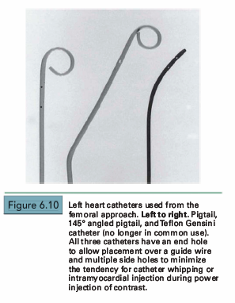
Catheter selection
The initial left heart catheter in most cases is a pigtail catheter with end- and multiple side holes
Developed by Judkins
Its end hole permits its insertion over a J-tipped guidewire.
The loop shape keeps the end hole away from direct contact with the endocardium, while the multiple side holes on the catheter shaft located up to several centimeters proximal to the pigtail loop provide numerous simultaneous exit paths for the contrast material.
These offset jet directions help stabilize the catheter within the left ventricle during contrast injection and reduce the magnitude of catheter recoil.
This virtually eliminates the possibility of endocardial staining, since the end hole usually is not positioned adjacent to ventricular trabeculae, and substantially reduces the occurrence of ventricular ectopic beats

Slide 19
The original Judkins pigtail design had a straight shaft leading up to the pigtail end.
Designed to sit directly under the aortic valve, and just in front of mitral inflow, relying on that inflow to distribute contrast to the apex of the left ventricle. In routine practice, this has been replaced by angled pigtail catheters , which have a 145° to 155 ° shaft angle at its distal end
This angle mimics the angle between the aortic root and the long axis of the left ventricle and helps the catheter achieve a central position within the left ventricle.

Slide 21
Straight tip left ventriculographic catheters
Sones catheter: widely used for left ventriculography when catheterization was performed from the brachial approach
Suitable for left ventriculography because it has four side holes in addition to its end hole. This catheter comes in 5F, 6F,7F, and 8F sizes; it tapers to a smaller external diameter near its tip.
The catheter will accept a 0.035-inch guidewire which can be useful in crossing severely stenotic aortic valves.
For left ventriculography, the Sones catheter should be positioned in an axial orientation (parallel to the ventricular long axis), with its tip midway between the aortic valve and left ventricular apex.
Low injection rates usually minimize the extent and forcefulness of catheter recoil.
Catheter recoil may still occur with induction of multiple ventricular extrasystoles and potential danger of endocardial staining

Slide 22
The NIH and Eppendorf catheters have multiple side holes and no end hole
They are easily inserted through an arteriotomy (by the brachial approach) or percutaneously through a femoral arterial sheath.
The NIH and Eppendorf can be gently prolapsed across the aortic valve, but of course cannot be aided by a leading guidewire because of the lack of an end hole.
The Cordis NIH (polyurethane) and Cook NIH Torcon blue (polyethylene) catheters are relatively soft and unlikely to cause dissection or perforation.
The Lehman ventriculographic catheter has a tapered closed tip that extends beyond the multiple side holes
The tapered tip may assist the operator in manipulating the catheter through tortuous arteries and across a stenotic aortic valve.
Once in the left ventricle, the tip lessens the likelihood of endocardial staining, but may increase the chance of ventricular ectopy during the injection of contrast material.

Slide 23
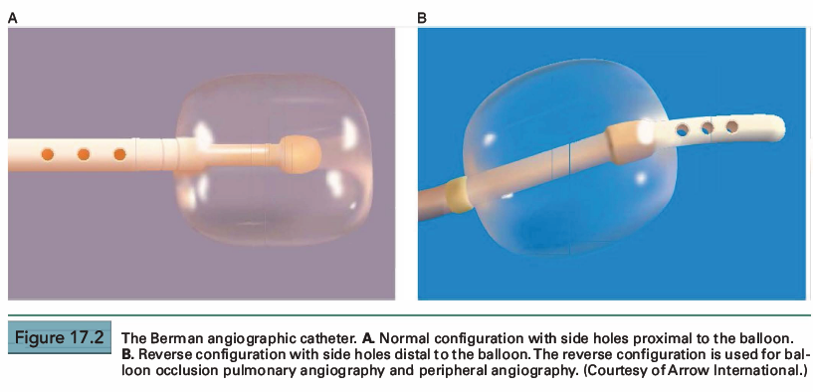
Balloon tip ventriculographic catheters
The Berman angiographic catheter is a balloon tip catheter
Available in 4F, 5F, 6F, 7F, and 8F sizes.
Used for right ventriculography, pulmonary angiography, peripheral angiography, and in the reverse configuration for balloon occlusion angiography
The balloon tip provides the advantage of easier advancement in the right ventricle or in the pulmonary artery, and by keeping the catheter and side holes away from the endocardium, it can reduce the risk of myocardial staining and ventricular arrhythmias.

Slide 24
Crossing the aortic valve
After measurement of the ascending aortic pressure, the pigtail catheter is then advanced across the aortic valve and into the left ventricle.
If the aortic valve is normal and the pigtail is oriented correctly, it will usually cross the valve directly.
In many cases it may be necessary to advance the pigtail down into one of the sinuses of Valsalva to form a secondary loop.
As the catheter is withdrawn slowly, this loop will open to span the full diameter of the aorta, at which point a very subtle further withdrawal will often cause the pigtail to fall across the valve.

Slide 26
If significant aortic stenosis is present, the pigtail must be advanced across the valve with the aid of a straight 0.038-inch guidewire.
Approximately 6 cm of the guidewire is advanced beyond the end of the pigtail catheter, and the catheter is withdrawn slightly until the tip of the guidewire is leading.
The position of the tip of the guidewire within the aortic root can then be controlled by rotation of the pigtail catheter and adjustment of the amount of wire that protrudes; less wire protruding directs the wire tip more toward the left coronary ostium, whereas more wire protruding directs the wire more toward the right coronary ostium.
With the wire tip positioned so that it is directed toward the aortic orifice, the tip of the wire usually quivers in the systolic jet.
Wire and catheter are then advanced as a unit until the wire crosses into the left ventricle .

Slide 27
If promising wire positions are not obtained, the process should be repeated using a different catheter: a left Amplatz (AL l ) catheter if the aortic root is normal or dilated or a Judkins right coronary catheter if the aortic root is unusually narrow together with a straight wire.
It is important to note that when crossing the aortic valve with catheters other than the pigtail, a left anterior oblique (LAO) or anteroposterior view should be used in order to prevent inadvertent advancement of the straight wire in the coronary ostium.
Once the tip of the wire has crossed the valve , the RAO angle should be used to visualize the position of the wire in the ventricular cavity and prevent perforations.
Once the catheter is in the left ventricle, the wire is immediately withdrawn and the catheter is aspirated vigorously, flushed, and hooked up for pressure monitoring, so that a gradient can be measured even if the catheter is rapidly ejected from the left ventricle or must be withdrawn because of arrhythmias.

Slide 28
The same approach applies to retrograde catheterization across a porcine aortic valve prosthesis , although it is more common to use a J-tip guidewire to help avoid the area between the support struts and the aortic wall.
Ball valves (Starr-Edwards) can be crossed retrograde with this approach, but use of a small (4F or 5F) catheter will minimize the amount of aortic regurgitation resulting from catheter interference with diastolic ball seating.
Tilting disc valves (Bjork-Shiley, St. Jude , Carbomedics) should not be crossed retrograde because of the potential for producing torrential aortic regurgitation, catheter entrapment, or even disc dislodgement if the catheter passes across the smaller (minor) orifice.

Slide 29
Injection site
Adequate opacification of either ventricle is accomplished only if a large amount of contrast material is delivered in a short period of time.
Satisfactory opacification of the left ventricle can sometimes be achieved by injection of contrast material into the left atrium - requires trans-septal catheterization, does not allow evaluation of mitral valvular incompetence, and may obscure the basal portion of the left ventricle and the aortic valve.
Similarly, the left ventricle may be opacified by aortography in patients with significant aortic regurgitation, and the right ventricle may be opacified by injecting contrast material into the venae cavae or right atrium.
The best approach to ventriculography in the adult patient is via injection of contrast material directly into the ventricular chamber in question.

Slide 30
In the left ventricle, the optimal catheter position is the midcavity.
The midcavitary position ensures
(a) adequate delivery of contrast material to the chamber's body and apex;
(b) lack of interference with mitral valvular function, which would have otherwise produced factitious mitral regurgitation;
(c) positioning of the holes through which the contrast material is injected away from ventricular trabeculae

Slide 32
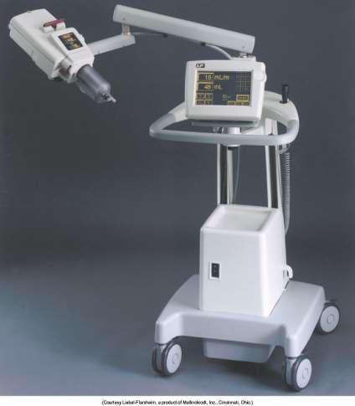
Power injectors
Flow injectors (Medrad)
- volume and rate of delivery can be selected
- maximal pressure limit of 1000psi to minimize the risk of catheter burst
- this high pressure is not actually delivered to the catheter tip , but is dissipated as frictional losses in the shaft of the catheter
- can be synchronised with R wave, so that a set flow rate is delivered in each of several successive diastolic intervals
- hand injection should be avoided

Slide 33
Procedure
Cine left ventriculography with
contrast vol – 30-36ml
rate – 10-12ml/sec(pig tail)
7-10 ml/sec(sones)
Older imaging systems required image acquisition at deep inspiration.
Newer imaging systems permits imaging during normal quite breathing.

Slide 34
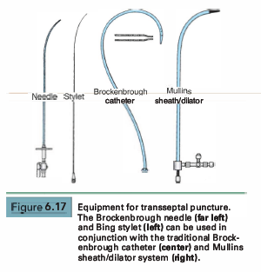
Transseptal catheterization
PBMV,Access to pulmonary veins.
Complication rate <1%.
Procedure:
• 8F Mullins transseptal sheath and dilator
• Brockenbrough needle. 18 G -21G at tip.
• 0.032 inch guide wire – FV - RA – SVC.
• Mullins sheath and dilator advanced over the wire into SVC.
• Guidewire is removed and replaced by Brockenbrough needle.
• Catheter is rotated from 12 o’– 5 o’ clock position.
• Two abrupt right ward movements. – SVC to RA, Limbic edge of fossa ovalis.
• Septal puncture done under fluoroscopy guidance.
• LA pressure recorded.
• LV angiography if needed – slight counterclockwise rotation.

Slide 35
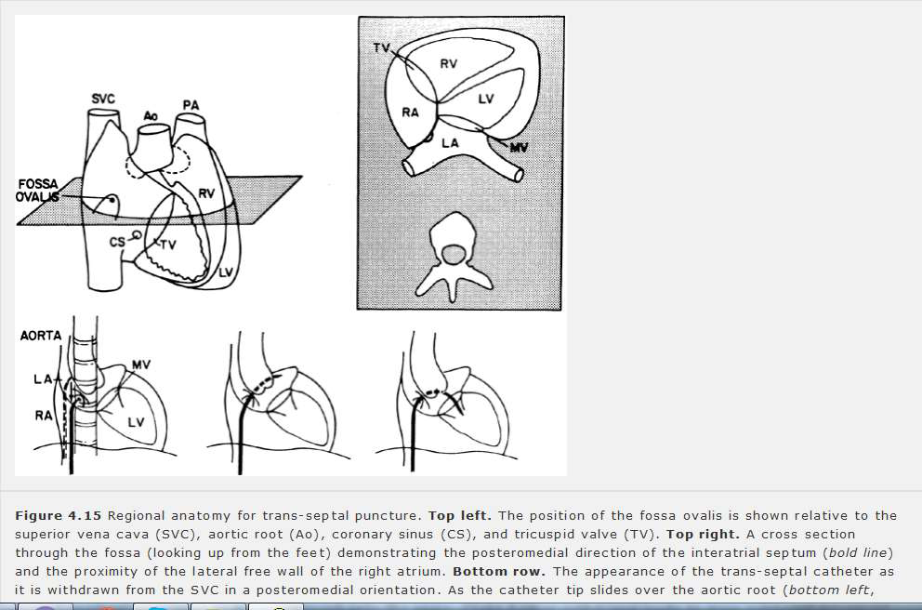

Slide 36
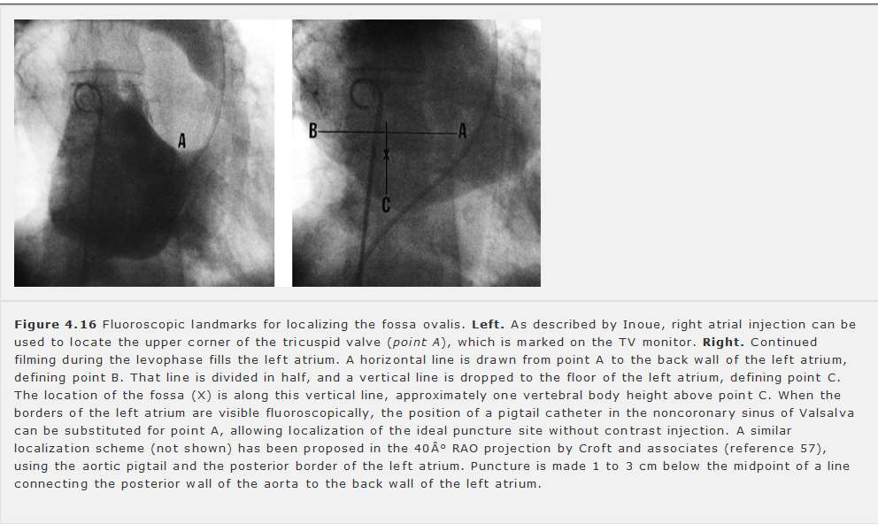

Slide 38
Apical left ventricular puncture
Measure LV pressure and perform ventriculography in patients with mechanical prosthetic valves in both the mitral and aortic positions that prevent both retrograde and transseptal catheterization.
Crossing of tilting disks to be avoided – catheter entrapment, occlusion of the valve, possible dislodgement and embolization of the disc.
Localization of LV apex by palpation or by echocardiography.
18 G 6” inch Teflon catheter system is inserted at upper rib margin, directed slightly posteriorly and toward the right second intercostal space.
Needle and sheath are advanced into the LV.
Stylet and the needle removed.
Sheath connected for pressure measurement.

Slide 39
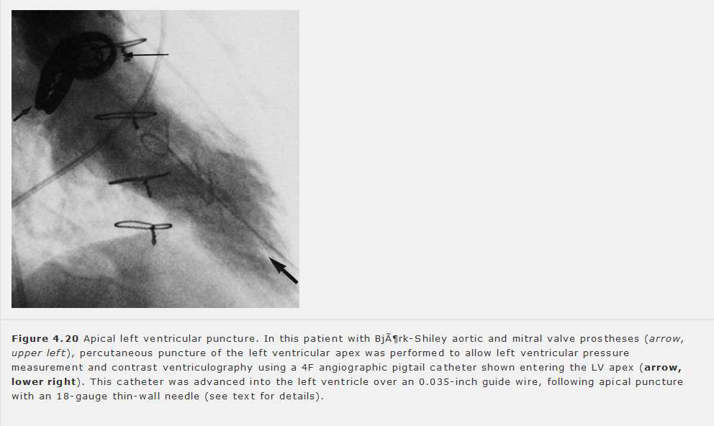

Slide 40
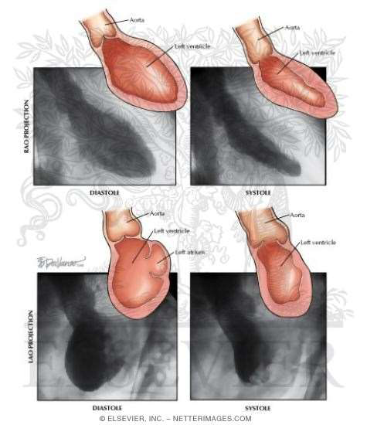
Filming projection and technique
Projection – max delineation of structure of interest and min overlapping of other structures
Cine left ventriculography
– 15-30 frames/sec
Typically 30 deg RAO and 60 deg LAO views are obtained
30 deg RAO
eliminates overlap of LV and the vertebral column
anterior apical inferior segmental wall motion
mitral valve profile ideal for assessment of MR

Slide 41
60 deg LAO
- assess ventricular septal integrity and motion
- lateral and posterior segmental function
- aortic valvular anatomy
- 15-30 deg cranial angulation for profiling entire IVS in case of VSD and the associated left to right shunting or the septal bulge and SAM in HOCM or isolated LW motion abnormalities

Slide 42
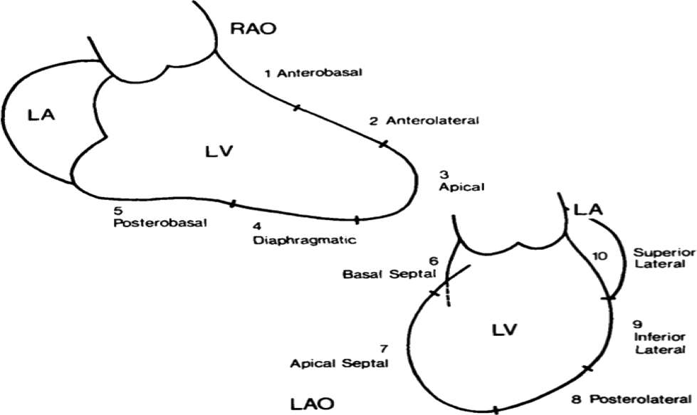
Normal LV angiogram - schematic

Slide 43
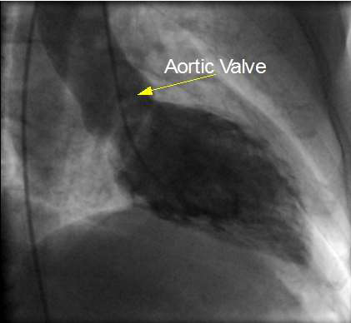
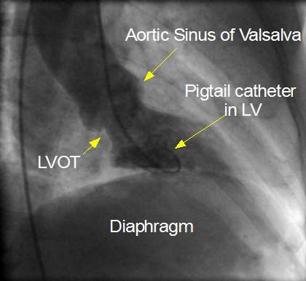
Normal LV angiogram
RAO diastolic frame RAO systolic frame

Slide 44
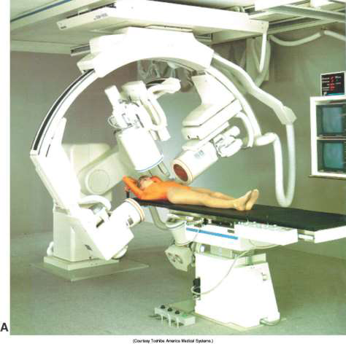
Biplane ventriculography
Better than single plane ventriculography.
-more information at no additional risk.
-single injection of contrast.
-coronary artery disease, biplane left ventriculography provides more information on the location and severity of segmental wall motion abnormalities
-in the patient with congenital heart disease biplane right ventriculography allows one to assess accurately the anatomy of the right ventricular outflow tract, the pulmonic valve , and the proximal portions of the pulmonary artery.
Disadvantages
Higher cost
Additional time
Reduced quality of
cineangiographic images
4. Additional radiation exposure

Slide 45
Views for specific conditions

Slide 46
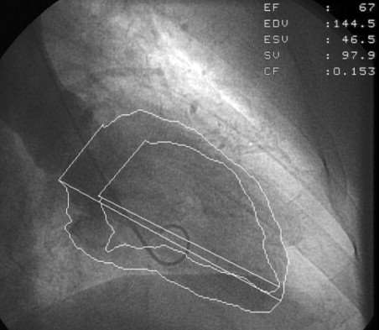
Steps in LV volume calculation
1.Tracing LV outline or
silhoutte
2.Marking aortic valve
border
3.Calculation of LV
volume by computer
based algorithms
4.Magnification
correction
5.Applying Regression
Equation

Slide 47
LV function assessment
Cineventriculography was the first method introduced in the routine practice to determine the LVEF.
The area-length technique is the most widely used method to quantify the left ventricular diastolic and systolic volumes.
In the first step in assessing left ventricular chamber volume, the left ventricular outline or silhouette is traced.
The ventricular silhouette should be traced at the outermost margin of visible radiographic contrast so as to include trabeculations and papillary muscles within the perimeter
To facilitate the calculation of left ventricular volume, the ventricle is often approximated by an ellipsoid

Slide 48
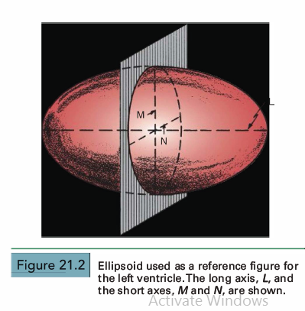
Biplane formula
May be performed in the anteroposterior (AP) and lateral projections, the 30° right anterior oblique (RAO) and 60° left anterior oblique (LAO) projections, or angulated projections (e.g. , 45° RAO and 60° LA0- 25° cranial).
The vol of an ellipsoid is given by the equation
V is volume, L is the long axis, and M and N are the short axes of the ellipsoid. The long axis, L, is taken practically to be Lmax the longest chord that can be drawn within the ventricular silhouette in either projection

Slide 49
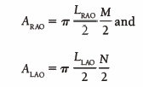
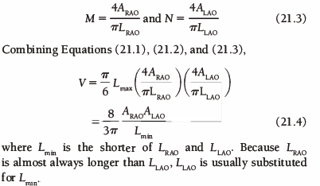
For biplane oblique (RAO/LAO) left ventriculography, for example, the areas of the two ventricular silhouettes are given as
LRAo and LLAo are the longest chords that can be drawn in the RAO and LAO silhouettes
The area of each traced silhouette is obtained by planimetry, and M and N are calculated by rearrangement as follows

Slide 50
Single plane formula
The area-length ellipsoid method for estimating left ventricular chamber volume has been modified for use in the usual situation in which only single-plane measurements obtained in the AP or RAO projection are available
Inherent in single-plane methods is the assumption that the left ventricular shape may be approximated by a prolate spheroid-that is, an ellipsoid in which the two minor axes are equal
If only single-plane (e.g. , RAO) ventriculography is done, it is assumed that M = N and that L in the plane presented is the true long axis of the ellipsoid. M is calculated from the single plane silhouette area (A) and L by the area-length method as M = 4A/πL.
Therefore, the single-plane volume calculation becomes

Slide 51
Magnification correction: Single Plane
Because the x-rays emanate from a point source, they are nonparallel, correction must be made for magnification of the ventricular image onto the detector
Correction may be accomplished by imaging a calibrated grid at the estimated level of the ventricle and submitting the grid to the same magnification process as that to which the ventricle is subjected.
In the single-plane formula, the cube of the linear correction factor adjusts the volume for magnification:

Slide 52
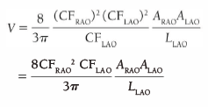
Magnification correction: Biplane
In biplane studies , a correction factor ( CF) must be calculated separately for each projection, yielding, in the case of biplane oblique cineangiography, CF RAO and CF LAO·
The linear correction factor is multiplied by the measured lengths , and the square of this correction factor is multiplied by planimetered areas to convert to true lengths and areas.
Accordingly the corrected volume of ventricle is

Slide 53
Regression equations
Ventricular volumes calculated by most mathematical techniques overestimate true ventricular chamber volume, so that regression equations must be used to correct for the overestimation
This overestimation results in large part from the papillary muscles and trabeculae carneae, which do not contribute to blood volume but are nevertheless included within the traced left ventricular silhouette

Slide 54
Calculation of LVEF
Visual inspection of the cine images allows selection of frames depicting the maximum (end-diastolic) and minimum (end systolic) ventricular volumes
Angiographic stroke volume
SV = EDV – ESV
Ejection fraction, EF = (EDV – ESV) / EDV

Slide 56
Calculation of RF
In patients with aortic and/or mitral regurgitation, comparison of the angiographically determined stroke volume with the forward stroke volume determined by the Fick technique or (in the absence of concomitant tricuspid regurgitation) the thermodilution technique yields the regurgitant stroke volume, that portion of the ejected volume that is regurgitated and therefore does not contribute to the net cardiac output.

Slide 57
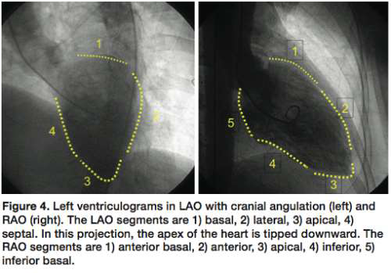
Regional LV dysfunction
Regional wall motion can be graded qualitatively as normal, hypokinetic, akinetic, dyskinetic, or hyperkinetic.
The analyses of the RAO and LAO projections as the following segments:

Slide 58
Permanent segmental dysfunction of the left ventricular wall can be caused by frank infarction, but reversible segmental dysfunction can also be caused by ischemia
Left ventricular segmental wall motion can be improved substantially by the administration of catecholamines.
Two left ventriculograms are performed-the first in the resting (baseline) state and the second during a steady state infusion of epinephrine (l to 4 mg/minute) or dobutamine ( 10 to 15 microg/kg per minute) .
Alternatively, left ventricular segmental wall dysfunction can often be improved by administration of nitroglycerin, either by improving collateral blood flow, reducing myocardial oxygen consumption to match available supply, or simply by reducing the after load against which the left ventricle must eject

Slide 59
Left ventricular segmental wall motion can be influenced by postextrasystolic potentiation when a single ventricular premature beat is introduced during left ventriculography and is followed by a potentiated beat.
Segmental wall motion during one of the preceding sinus beats is compared with that of the postextrasystolic beat and improvement on the potentiated beat as compared with the preceding sinus beat suggests ischemia rather than infarction.
Segments in which wall motion improves with intervention generally maintain same level of improvement after successful surgical revascularization.

Slide 61
Calculation of stenotic valve area
GORLIN FORMULA
Torricelli's law:
Flow across a round orifice F = AV C_{C}
A = F/VCc
F = Flow rate A = Orifice area
V = Velocity of flow C_{C} = Coefficient of orifice contraction

Slide 62
2. Pressure gradient and velocity of flow Relation - Torricelli's law
V = velocity of flow
C_{v} = coefficient of velocity - correcting for energy loss as pressure energy is converted to kinetic or velocity energy
h = pressure gradient in cm H₂O
g = gravitational constant (980 cm/sec²) for converting cm H₂O to units of pressure

Slide 64
Flow (F) = Total cardiac output expressed in terms of the seconds per minute during which there is actually forward flow across the valve.
F= CO (ml or cm³/min)/SEP/DFP (sec/min) x HR
The diastolic filling period begins at mitral valve opening and continues until end-diastole.
The systolic ejection period begins with aortic valve opening and proceeds till the dicrotic notch or some other evidence of aortic valve closure.

Slide 65
SYSTOLIC EJECTION PERIOD CALCULATION

Slide 66
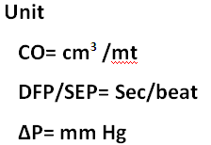
AREA CALCULATION FOR MITRAL VALVE & AORTIC VALVE

Slide 67
Mitral valve area
By rearranging the terms of Eq., one sees that for the mitral valve,
where ∆P is the mean transmitral pressure gradient and MVA is the mitral valve area.
Thus, by doubling cardiac output one will quadruple the gradient across the valve, if heart rate and diastolic filling period remain constant.
The normal mitral orifice in an adult has a cross-sectional area of 4 . 0 to 5 . 0 cm2 when the mitral valve is completely open in diastole.
Considerable reduction in this orifice area can occur without symptomatic limitation, but when the area is 1.0 cm2 or less , a substantial resting gradient will be present across the mitral valve and any demand for increased cardiac output will be met by increases in left atrial and pulmonary capillary pressure that lead to pulmonary congestion and edema.

Slide 69
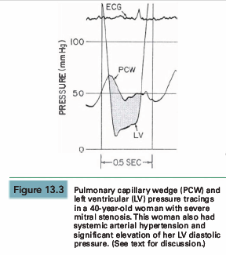
Example of valve area calculation in MS
40 year woman with RHD and severe MS, HTN
In this patient, five beats were chosen from the recordings taken closest in time to the Fick cardiac output determination.
Planimetry of the area between PCW and LV pressure tracings was done for these five beats, and these areas were divided by the length of the diastolic filling periods for each beat, giving an average gradient deflection in millimeters

Slide 70
Valve area calculation chart

Slide 71
The mean gradient in millimeters of mercury was calculated as the average gradient deflection in millimeters multiplied by the scale factor (mmHg/mm deflection).
In this case, the mean gradient was 30 mmHg.
Next, the average diastolic filling period was calculated using the average measured length between initial PCW-LV crossover in early diastole and end-diastole (peak of the R wave by ECG).
This average length in millimeters was divided by the paper speed (mm/second) to give the average diastolic filling period, which in this case was 0.40 second.
Heart rate and cardiac output are recorded, ideally from data collected simultaneously with the recording of the PCW-LV pressure gradient.
Heart rate was 80 bpm and cardiac output was 4,680 cm3/minute

Slide 73
Aortic valve area
For the aortic valve the Eq can be rearranged as
At a normal resting cardiac output of 5.0 L/minute, an aortic orifice area of 0. 7 cm2 will result in a pressure gradient of approximately 33 mmHg across the aortic valve.
Doubling of the cardiac output, as might occur with exercise, would increase the gradient by a factor of 4 to 132 mmHg if the systolic time per minute did not change.
This increase in gradient would require a peak LV pressure in excess of 250 mmHg to maintain a central aortic pressure of 120 mmHg.
Such a major increase in LV pressure obviously increases myocardial oxygen demand and limits ejection performance.
These factors contribute to the symptoms of angina and congestive heart failure , respectively.
The limitations in cardiac output imposed by high afterload may contribute to hypotension when peripheral vasodilation occurs during muscular exercise.

Slide 74
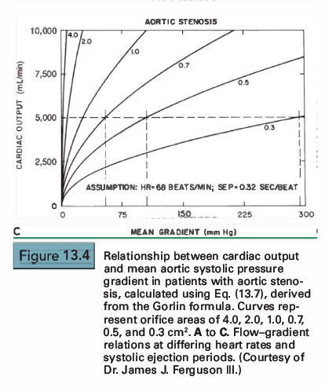

Slide 75
Actually, the systolic time per minute does not remain constant during the increase in cardiac output associated with exercise.
As heart rate increases during exercise , the systolic ejection period tends to become shorter, but the tendency is counteracted by both increased venous return and systemic arteriolar vasodilation, factors that normally help to maintain LV stroke volume constant (or even allow it to increase) during exercise.
Thus, the heart rate is increasing but the systolic ejection period is diminishing only slightly so that their product (the systolic ejection time per minute) increases

Slide 76
Example
Simultaneous pressure tracings from the left ventricle (LV) and right femoral artery (RFA) in a patient with exertional syncope.
Because the pulse wave takes a finite period of time to travel from the left ventricle to the femoral artery, the femoral artery tracing is somewhat delayed
LV and RFA tracings realigned to correct for the delay in transmission time.
This is accomplished by using tracing paper and aligning the arterial upstroke to coincide with the LV upstroke. After such an alignment, the mean pressure gradient can now be obtained by planimetry
For this example, the average aortic pressure gradient is 40 mmHg, the systolic ejection period is 0.33 second, the heart rate is 74 bpm, and the cardiac output is 5,000 mL/minute.

Slide 78
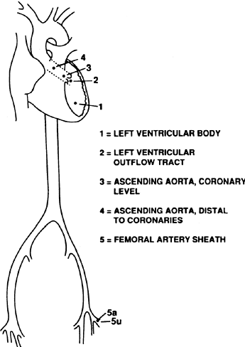
Gradient calculation LV-Ao
For accurate LV –AO gradient calculation by cath
Preferred catheter position for LV-Ao gradient calculation is LV body & Ascending aorta rather than LV & FA
Pressure recording simultaneously taken from AO and LV
Use Two catheter or Dual Lumen catheter (Langston Catheter)

Slide 79
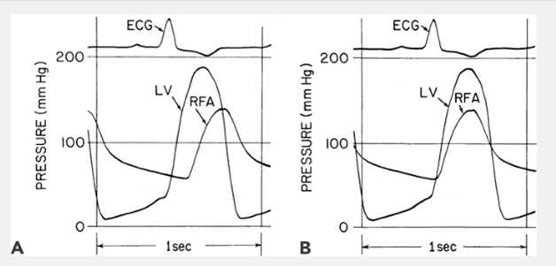
Errors in gradient measurement
1) Systolic amplification and widening of pressure waveform
LV-AO Gradient overestimated by 9 mm Hg
LV- AO Gradient underestimated by 10mm Hg

Slide 80
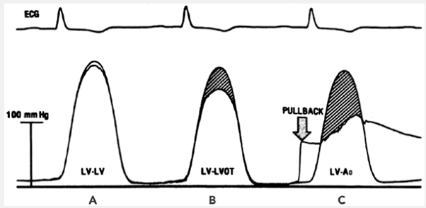
2) LV Catheter placed in LVOT
Substantial pressure gradient between the body of the LV & LVOT . This is due to acceleration of blood as it enters the relatively narrow outflow tract

Slide 81
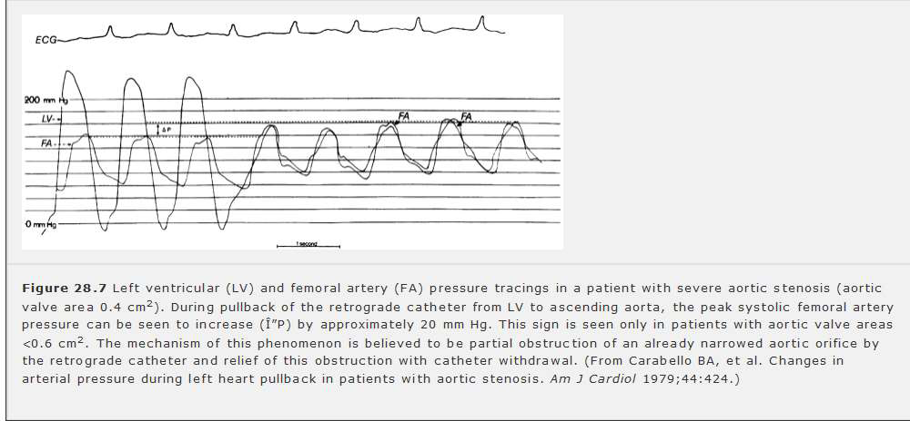
Carabello’s sign

Slide 82
When the aortic valve area is diminished to 0.6 cm2 or less, a 7F or 8F catheter placed retrograde across the valve takes up a significant amount of the residual orifice area, and the catheter may actually increase the severity of stenosis.
Conversely, removal of the catheter reduces the severity of stenosis.
A peripheral pressure rise occurs in severe aortic stenosis when the LV catheter is removed from the aortic valve orifice.
An augmentation of more than 5 mmHg i n peripheral systolic pressure at the time of LV catheter pullback indicates that significant aortic stenosis is present.
This sign is present in > 80% of patients with an aortic valve area of 0.5 cm2 or less

Slide 83
Alternative formula to Gorlin: Hakki formula
Assumption: Heart rate x SEP or DFP x Constant ≈1
When compared to the traditional Gorlin formula the above formula may lead to significant disparity if tachycardia is present (heart rate >100 beats/min).

Slide 84
Assessment of AS in patients with low cardiac output
Valve calculations made using the Gorlin formula are flow dependent
That is, as cardiac output increases, calculated area increases, and as cardiac output decreases, calculated area decreases
Two potential mechanisms exist by which calculated valve orifice area increases with cardiac output:
Increased flow through the stenotic aortic valve in conjunction with increased LV pressure physically opens the valve to a larger orifice area, and thus the valve orifice really is wider during increased flow, and
Inaccuracies in the Gorlin formula cause the calculated area (but not necessarily the actual orifice area) to be flow dependent.
The Gorlins themselves had noted that they had no data based on which they could derive an empirical constant for the aortic valve

Slide 85
Consider a patient with a reduced cardiac output and low LV ejection fraction who has both cardiomyopathy and mild aortic stenosis.
Despite a calculated valve area of 0.7 cm2, such a patient will probably not benefit from aortic valve replacement because aortic stenosis was not the cause of the LV dysfunction.
On the other hand, although patients with low aortic valve gradients are generally at higher risk for perioperative death associated with aortic valve replacement, many patients with low gradients may improve substantially following surgery.
It is likely that such patients have truly severe aortic stenosis, which is the cause of their hemodynamic decompensation; in these patients , correcting the aortic stenosis is beneficial.

Slide 86
Cautious hemodynamic manipulation in the catheterization laboratory can distinguish between these two different clinical entities
In patients with mild aortic stenosis, an infusion of nitroprusside or dobutamine increases forward output substantially, but may actually decrease the transvalvular gradient.
In such cases, the calculated aortic valve area increases dramatically and is no longer within the critical range.
In patients with truly severe aortic stenosis, infusion of nitroprusside widens the transvalvular gradient and increases the calculated aortic valve area only slightly, if at all.

Slide 87
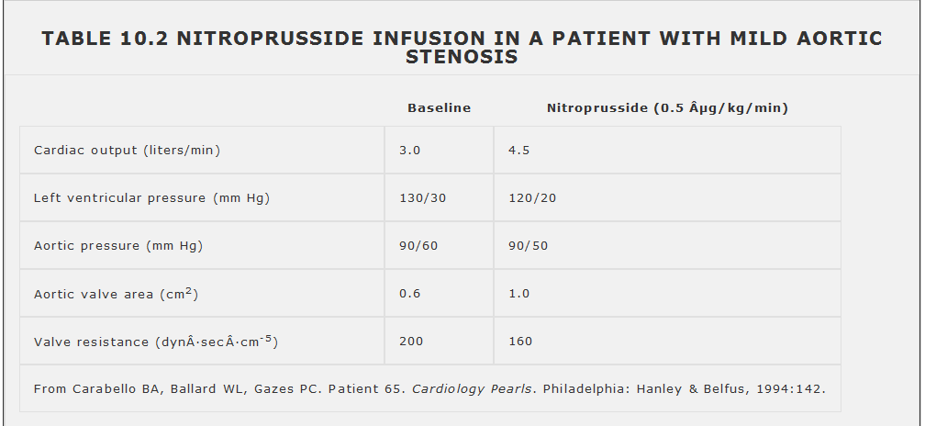

Slide 88
The patient's initial calculated valve orifice area was 0.6 cm2 , which would indicate a need for surgery.
Following nitroprusside infusion, the gradient actually fell and calculated valve area increased.
The patient improved on chronic vasodilator therapy, usually contraindicated in aortic stenosis unless the disease is mild.
Infusion of nitroprusside in patients with suspected aortic stenosis must be performed with great caution, because if true aortic stenosis is present, hypotension may result.
If it is known that the patient has normal coronary arteries, dobutamine, which produces similar changes in cardiac output, can be infused instead of nitroprusside.

Slide 89
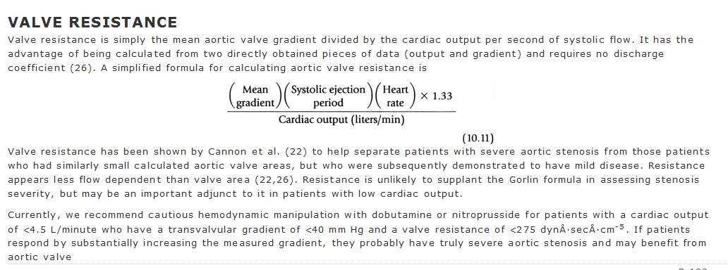

Slide 90
Mitral regurgitation
Diagnosis and assessment of severity of MR

Slide 91
Angiographic quantification of MR
Total Stroke Volume (TSV = EDV – ESV) calculated from LV angiogram.
Forward Stroke Volume(FSV) calculated by Fick method or indicator dilution technique.
Regurgitant Stroke Volume (RSV) = TSV – FSV
Regurgitant Fraction (RF) = RSV/TSV

Slide 94
Aortic regurgitation
+ small regurgitant jet only, LV ejects contrast each systole.
+ + regurgitant jet faintly opacifies LV cavity, not cleared with each systole.
+++ persistent LV opacification = Aortic root density; LV enlargement.
++++ Persistent LV opacification > Aortic root concentration, often marked LV enlargement.

Slide 95
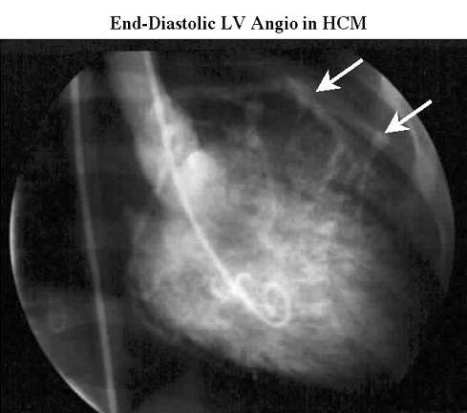
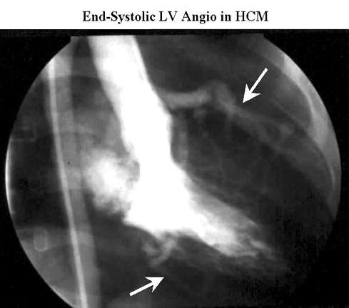
Hypertrophic cardiomyopathy
In HCM, cavity obliteration is commonly seen together with small ventricular end systolic volumes .
Systolic anterior motion of the mitral valve may result in severe degrees of mitral regurgitation.
The ventriculogram in the apical variant typically appears with a “spade”- shaped contour.

Slide 96
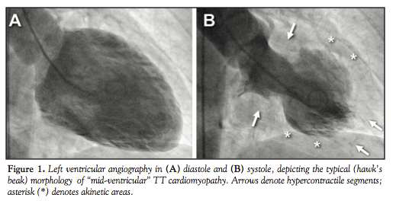
Tako Tsubo Cardiomyopathy
Diffuse akinesis of LV apex with preserved basal contractilty.
Characteristically resemble the shape of a japanese octopus trap(tako-tsubo)

Slide 97
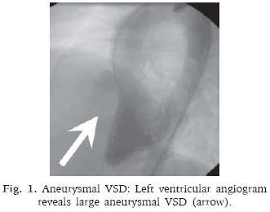
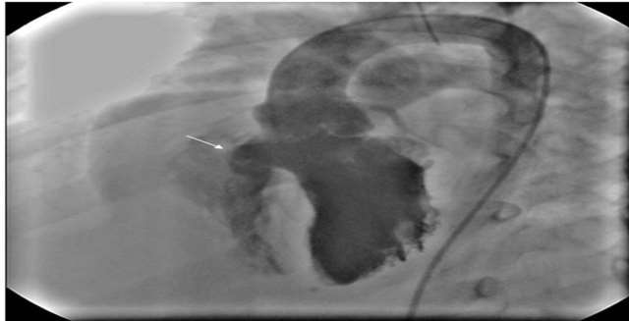
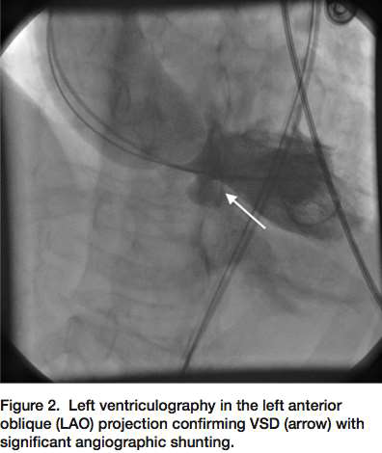
Ventricular septal defect
A standard view in the evaluation of patients with ASDs or muscular VSDs is the hepatoclavicular view at 30◦ to 45◦ LAO and 30◦ to 45◦ cranial

Slide 99
Complications
Ventricular extrasystole – mechanical stimulation
Ventricular tachycardia – mostly NSVT
Intramyocardial injection/endocardial staining
Myocardial perforation
Left anterior fascicular block
Transient complete heart block
Embolism- air/thrombus
Complications of contrast media

Slide 100
Conclusion
Left heart catherization has a significant role in quantifying the pressure gradients across the valve and within the left ventricle.
Mostly being used presently during therapeutic indications rather than diagnostic indications.
Optimal pressure tracings with all necessary precuations and knowing the limitations of each helps in judging the severity of the clinical condition to the nearest accuracy.

Slide 101
Thank you!

